Slide 1
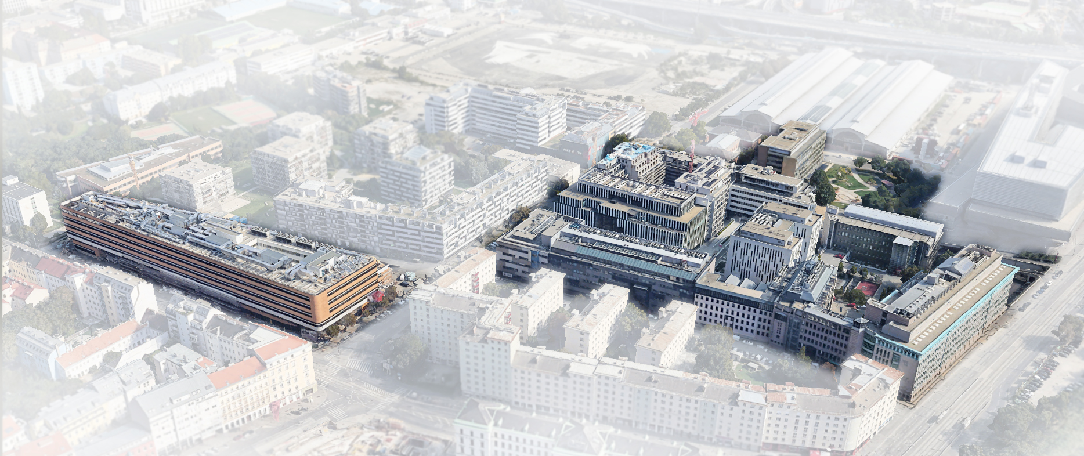
VIENNA BIOCENTER
6 Basic Research Institutions
141 Research Groups
75 ERC Grants
280 PostDocs
386 PhD students
32 EMBO members
13 Wittgenstein Awards
1 Breakthrough Prize
Training of International Talent:
Summer School and Master programs
Research-driven PhD Program
Postdoctoral Training
38 Biotech Companies
13 Shared Core Facilities, incl. Child Care Center
2,685 Staff: 78 nationalities
www.viennabiocenter.org
Stand: Feb 2022

